Slide 1

VIRTUAL ROOM 19 DBS HAC 2 HIRE

Slide 2
PROBLEM STATEMENT
BANKING MADE SIMPLE FOR HNIs
APPROACH
STEP 1 : WE HAVE CREATED A LANDING PAGE SEPERATELY FOR THE HIGH NETWORTH INDIVIDUAL AND WELTH MANAGER.
STEP 2: THEN WE HAVE CREATED A DATA BASE BANKING_INFO WITH BANKING DETAILS OF HNI’s AND SORTED THEM ACC TO THEIR ASSET VALUE OR BANK ACCOUNT BALANCE .
STEP 3:WE HAVE CREATED A NEW TABLE FOR WELTH MANAGERS WITH PRIMARY KEY AS WELTH_MANAGER_ID WHICH IS FORIGN KEY TO THE TABLE BANKING_INFO.

Slide 3
BANKING_INFO
BANK_ID | BANKING_NAME | ACCOUNT_BALANCE | WORK_MANAGER_ID
123 | SUNIL BHAT | 20000009 | 101
124 | SONIYA MEHTA | 30000009 | 101
125 | RAJES SHRMA | 20000 | 102
126 | MUKESH VERMA | 50000087 | 102
127 | JHON SNOW | 20674678 | 103
128 | MADY SINGH | 25340009 | 103
129 | SALMAN REDDY | 27950005 | 104
130 | KUMAR JAIN | 46780009 | 104

Slide 4
WORK_MANAGER
WORK_MANAGER_ID | WORK_MANAGER_NAME | BANK_ID
101 | VEENITHA SAI | 123
102 | NIKHIL RAJ | 125
103 | SOMESH RAO | 127
104 | ANIKET REDDY | 128

Slide 5
NOW THE HNI’s WITH BALANCE>2CR ARE SORTED
BANK_ID | BANKING_NAME | ACCOUNT_BALANCE | WORK_MANAGER_ID
123 | SUNIL BHAT | 20000009 | 101
124 | SONIYA MEHTA | 30000009 | 101
126 | MUKESH VERMA | 50000087 | 102
127 | JHON SNOW | 20674678 | 103
128 | MADY SINGH | 25340009 | 103
129 | SALMAN REDDY | 27950005 | 104
130 | KUMAR JAIN | 46780009 | 104
BANK_ID
BANKING_NAME
ACCOUNT_BALANCE
WORK_MANAGER_ID

Slide 6
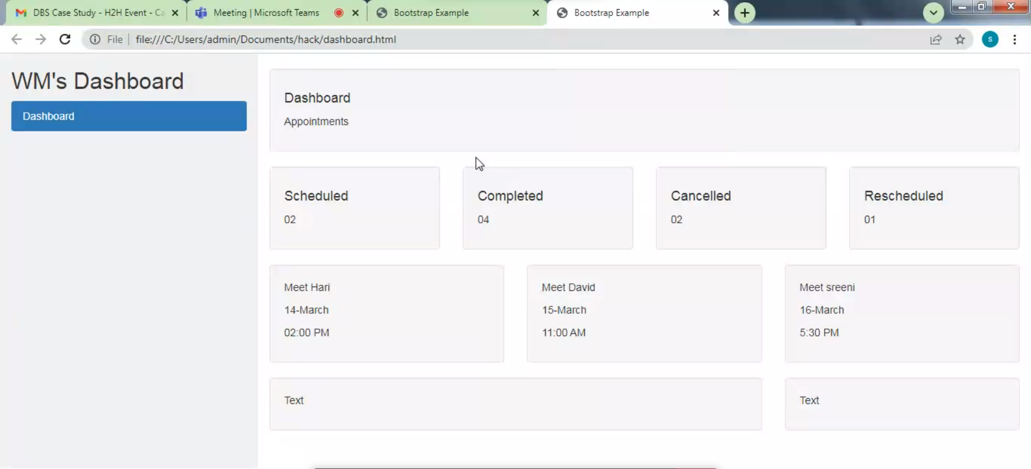
LANDING PAGE

Slide 7
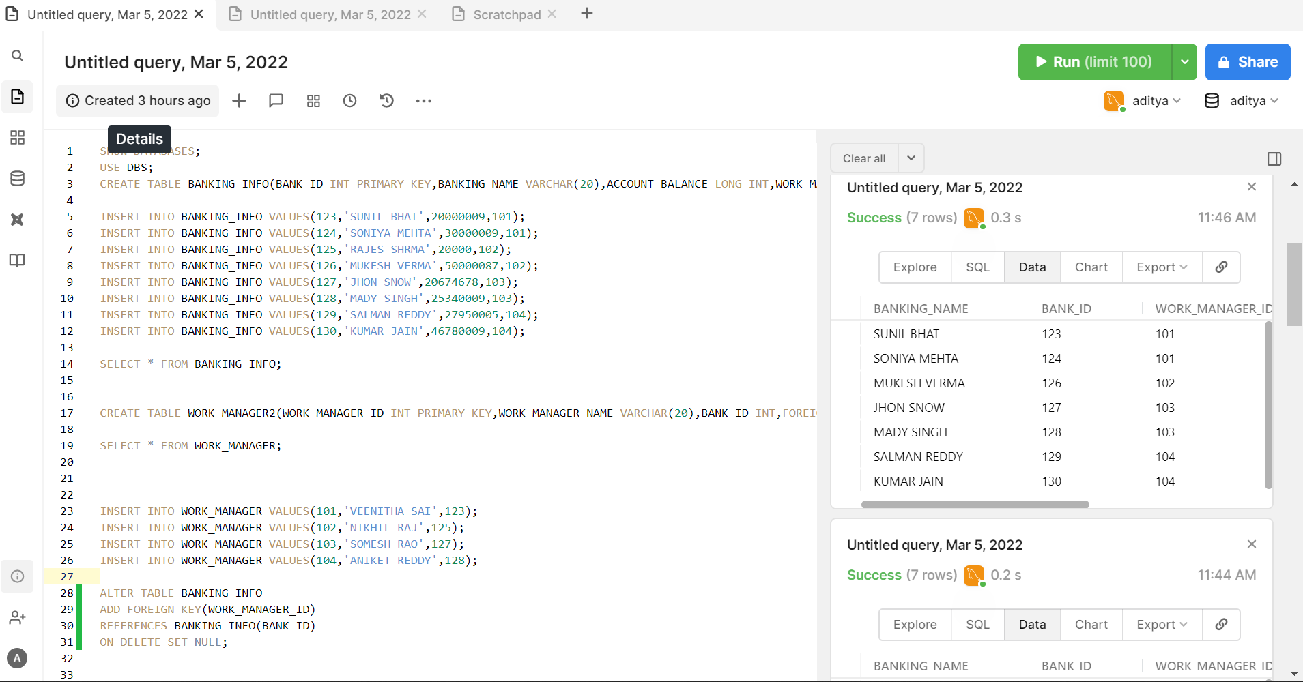

Slide 8
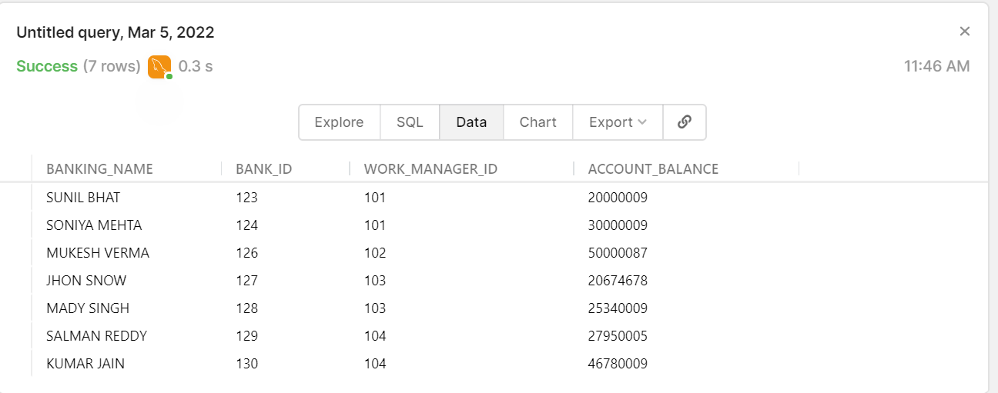
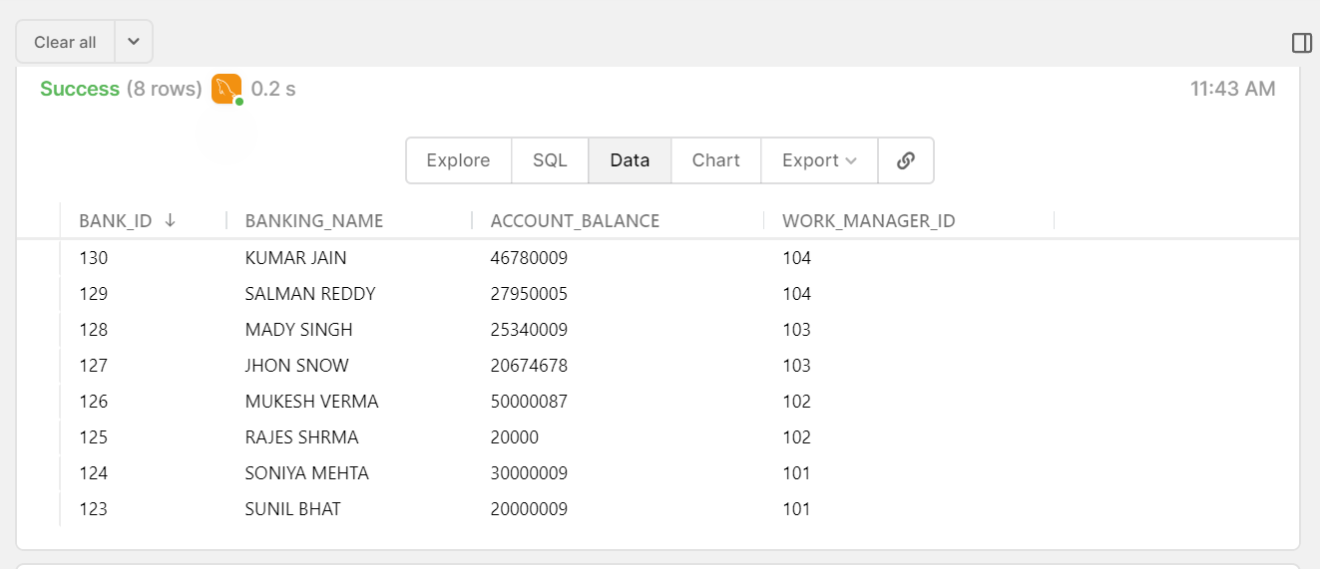
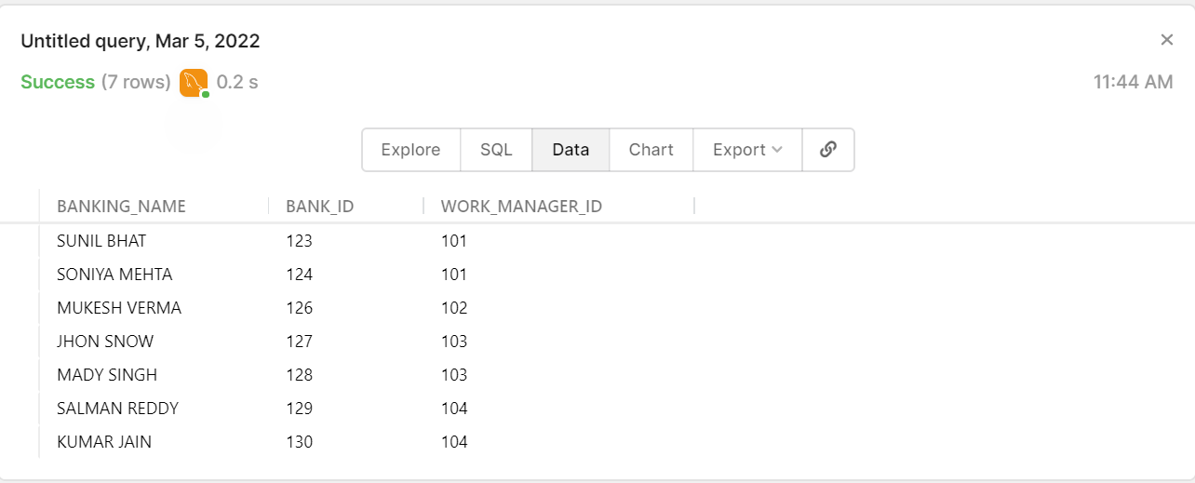

Slide 9
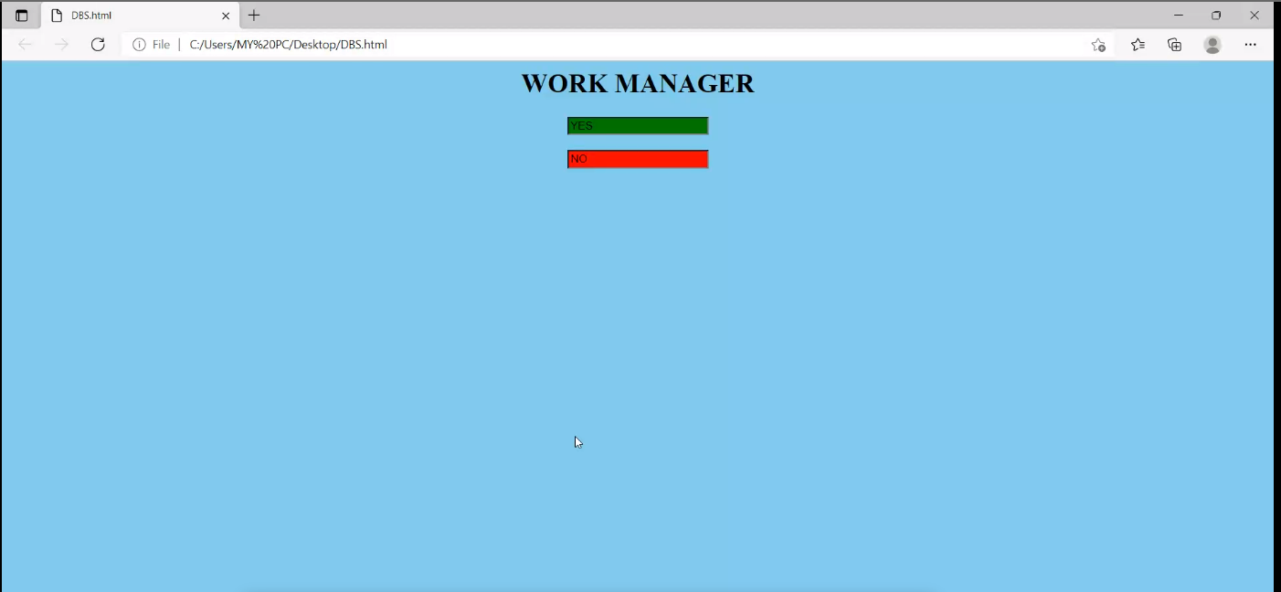
ACEEPTING REQUEST POP UP

Slide 10
THANK YOU

